Slide 1
Initiate a Review using the iPERMS Web Based Training Database

Slide 2
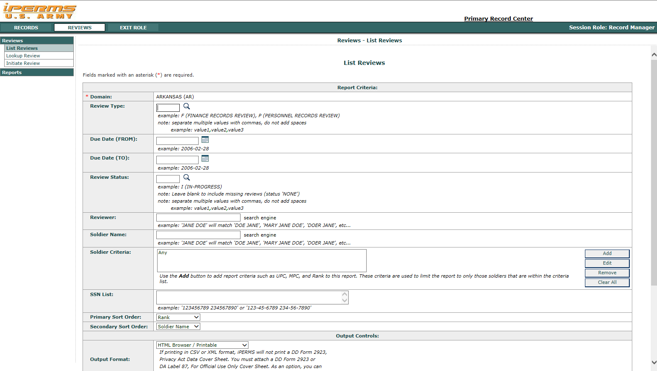
iPERMS Training Database List Review
Choose how to conduct Review

Slide 3
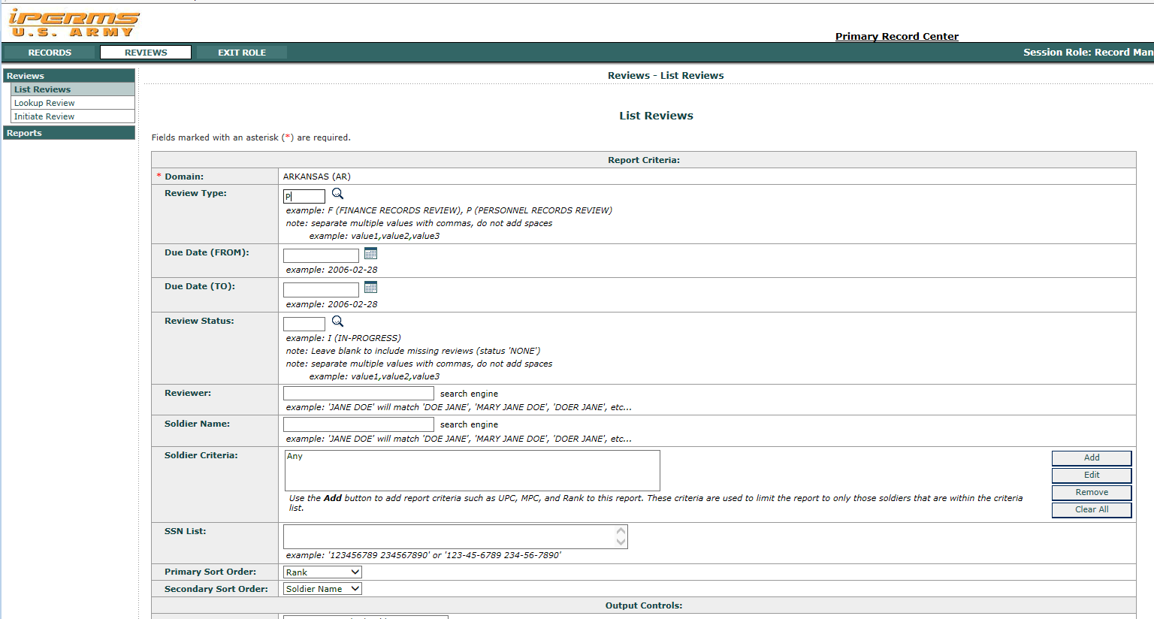
iPERMS Training Database List Review
Type “P” or “F” for review type
Select “Add” to search by UPC

Slide 4
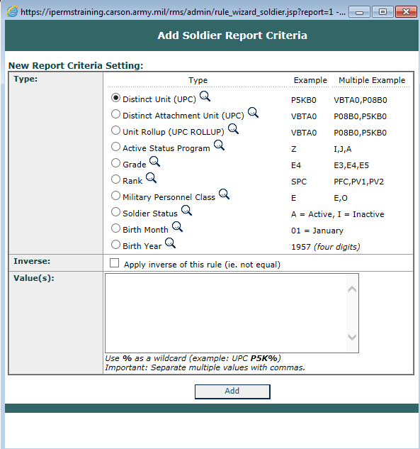
iPERMS Training Database List Review
Select “Distinct Unit (UPC)”

Slide 5
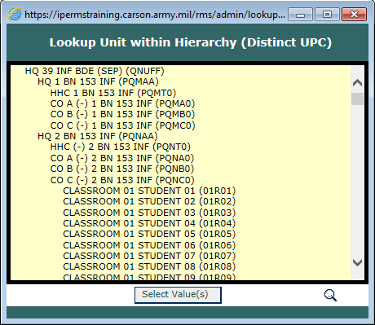
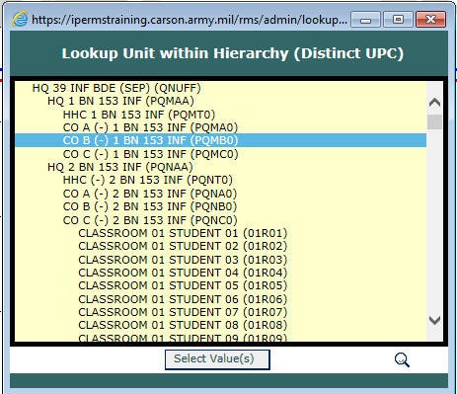
iPERMS Training Database List Review
Select a Unit to List Reviews
Click Select Values

Slide 6
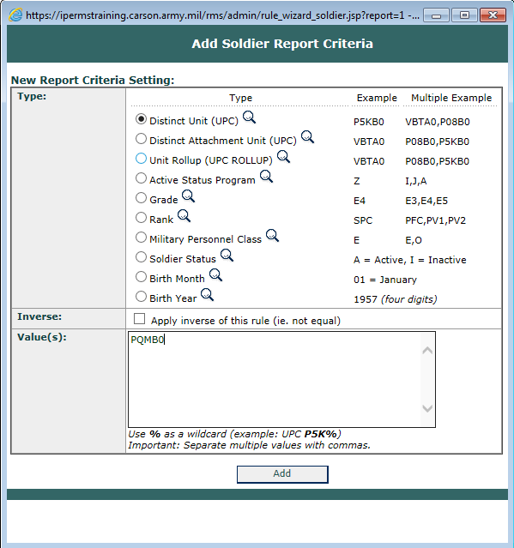
iPERMS Training Database List Review
Click Add

Slide 7
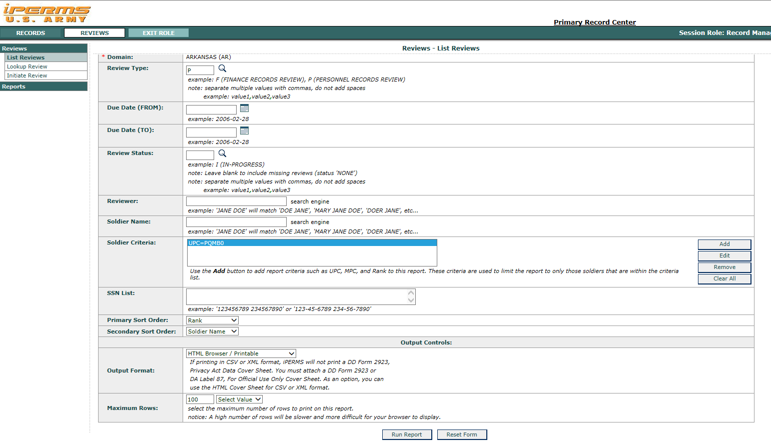
iPERMS Training Database List Review
Click Run Report

Slide 8
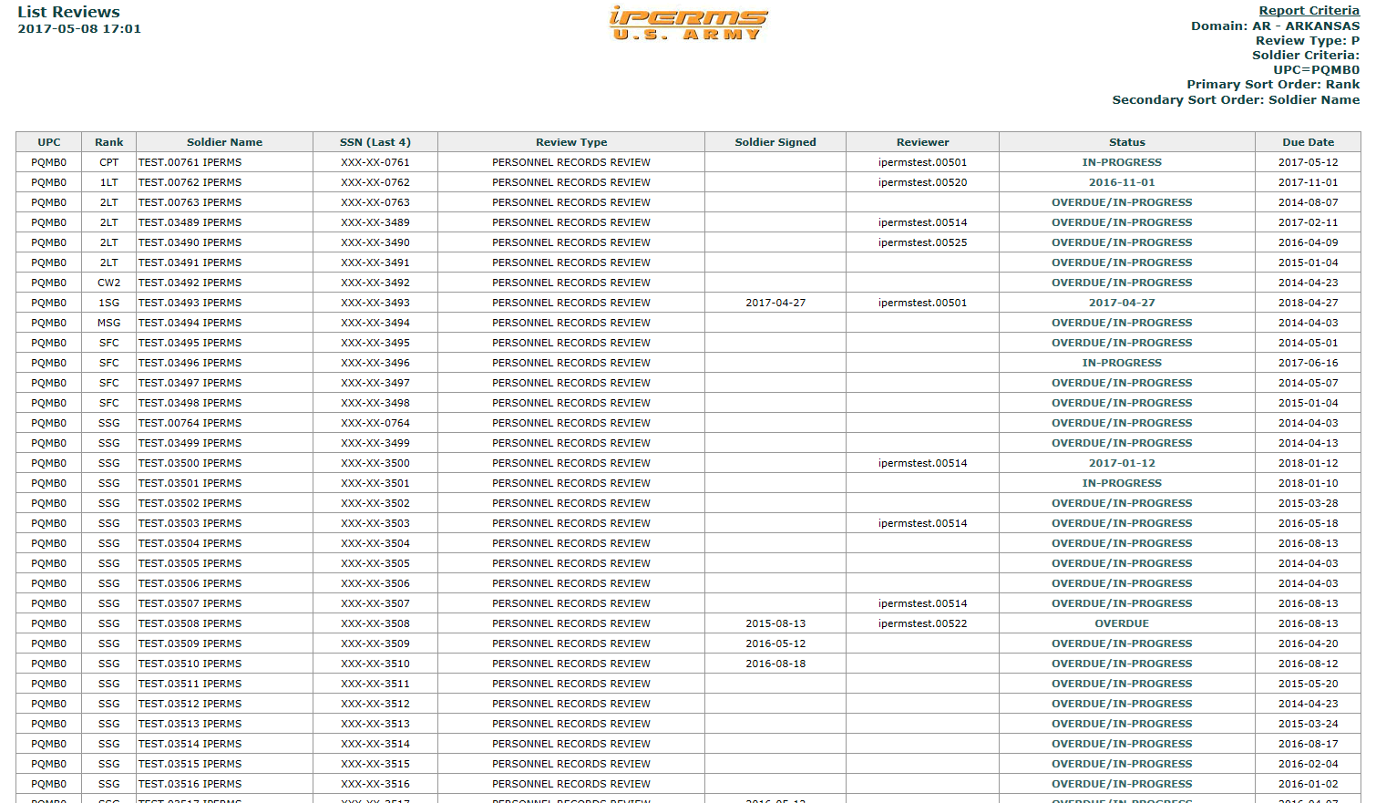
iPERMS Training Database List Review
Choose a record to review

Slide 9
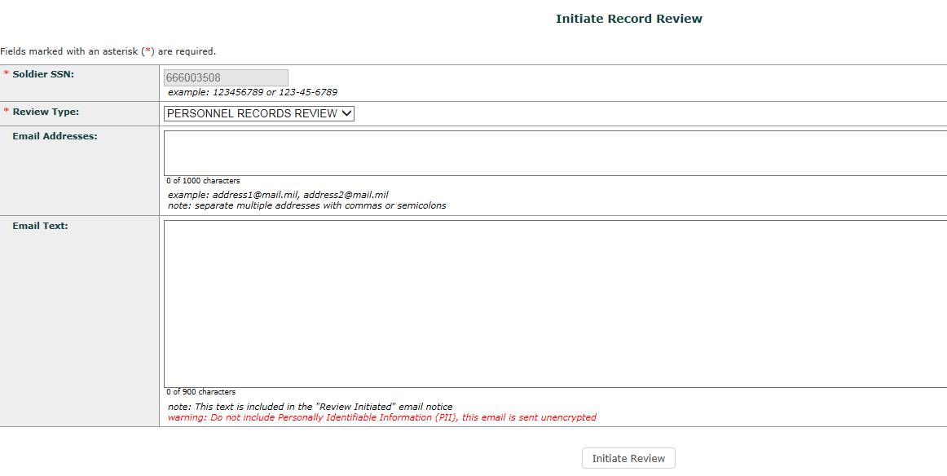
iPERMS Training Database List Review
Click Initiate Review

Slide 10
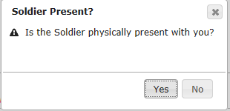
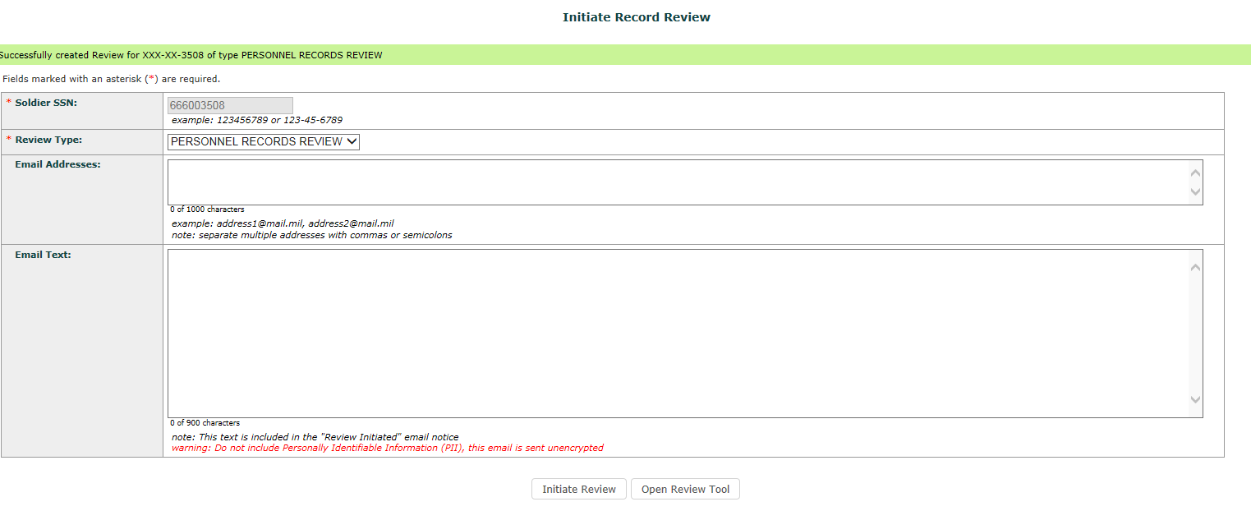
iPERMS Training Database List Review
Select Appropriate Box
Select Open Review Tool

Slide 11
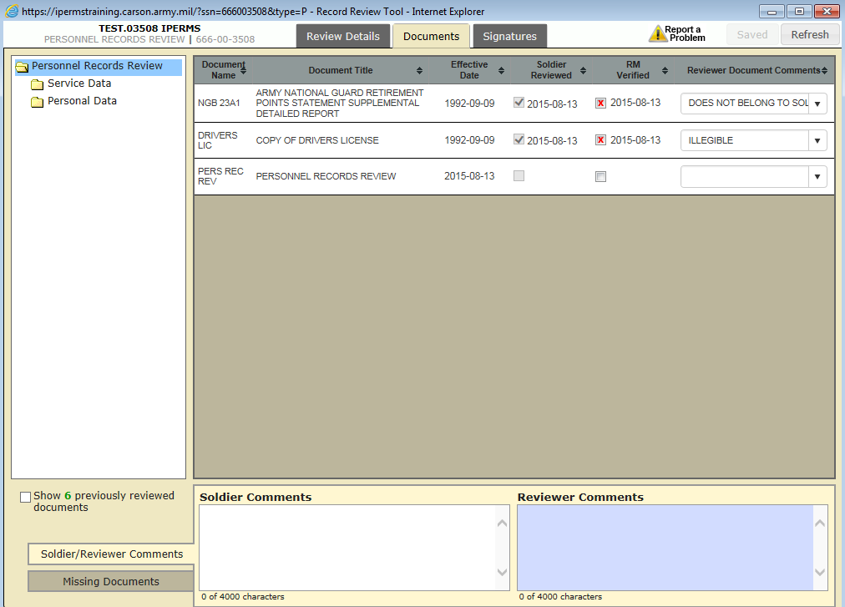
iPERMS Training Database List Review
Select “Documents to begin Review”

