Slide 1
General Fund Enterprise Business System (GFEBS)
Course-to-Roles-to-T-code
Crosswalk
1
Notes:
Show Slide 1: Communicate the GFEBS course-to-roles crosswalk
SECTION I. ADMINISTRATIVE DATA
Academic Hours / Methods
30 min Small or Large Group Instruction
SECTION II. INTRODUCTION: Today we are going to discuss the Course to roles crosswalk in GFEBS
Method of Instruction. Conference / Discussion
Instructor to Student Ratio: 1:16 or 1:25
Time of Instruction 0 hrs 30 mins
Media: Small or Large Group Instruction
Motivator: In today’s Army, we define ourselves as being the best trained, equipped and the best led Army that the United States has ever known. So to keep this image we as Financial Leaders and Managers have to become the best at financially supporting our Soldiers and being stewards of taxpayer dollars. Knowing this we have embraced Standard Financial Information System (SFIS) and the General Fund Enterprise Business System (GFEBS) in that it provides our Army decision makers with accurate, reliable, timely business and financial information to keep our War Fighters within their fiscal responsibilities.
Student Materials:
DFAS-IN Regulation 37-1, Finance and Accounting Policy Implementation
DFAS-IN Manual 37-100, The Army Management Structure
DODFMR 7000.14-R, Vol 10, Department of Defense Financial Management Regulation
GFEBS Funds Distribution Excel Spreadsheet
Student Funds Management PowerPoint slides
Access to AFMS TED 357

Slide 2
Terminal Learning Objective
Action: Conduct GFEBS Course-to-Roles-to-T-codes Crosswalk
Conditions: FM Leaders in a classroom environment using doctrinal and administrative publications, practical exercises, personal experience, handouts, discussion and access to GFEBS.
Standard: Analysis includes:
- Discuss GFEBS functional areas, master and transactional data
- Explain GFEBS Line of Accounting (LOA), prerequisites, and roles
- Describe the impact GFEBS has on all Army organizations.
- Explain the background & purpose of the GFEBS program
2
Notes:
Show Slide 2: Terminal Learning Objective
Read TLO
SAFETY REQUIREMENTS: In a training environment, leaders must perform a risk assessment in accordance with DA PAM 385-30, Risk Management. Leaders will complete a DD Form 2977 RISK MANAGEMENT WORKSHEET during the planning and completion of each task and sub-task by assessing mission, enemy, terrain and weather, troops and support available-time available and civil considerations, (METT-TC). Local policies and procedures must be followed during times of increased heat category in order to avoid heat related injury. Consider the
work/rest cycles and water replacement guidelines IAW TRADOC Regulation 350-29.
Risk Assessment Level: Low. Hazard Identification: Electrical Shock, Fire, Slippery Floors, Physical Injure/Strain, Tripping Tight Spaces in Classroom, and Influenza. Hazard controls: Primary Instructor (PI) will ensure: All electrical cords are properly stored under desks, liquid containers have lids on them and all spills are immediately cleaned and mopped and allowed to completely dry before allowing students/personnel to walk on them. All chairs are ergonomically designed, adjust to individual preference and that all students are awake and paying attention in class. All cables/cords are properly plugged in, sheathed, and secured along tables, walls, and ceilings. No damaged or frayed cords/cables will be used. PI will brief proper hand washing techniques, the use of hand sanitizer, and evacuation procedures. All trash will be removed daily.
ENVIRONMENTAL STATEMENT: Environmental protection is not just the law but the right thing to do. It is a continual process and starts with deliberate planning. Always be alert to ways to protect our environment during training and missions. In doing so, you will contribute to the sustainment of our training resources while protecting people and the environment from harmful effects. Refer to FM 3-34.5 Environmental Considerations and GTA 05-08-002 ENVIRONMENTAL-RELATED RISK ASSESSMENT.
EVALUATION. At the end of the S8 Module a culminating event, resulting in a briefing to the Commander, will be assessed.
INSTRUCTIONAL LEAD IN - Before we can understand how to control our funds, we must briefly discuss the course to roles crosswalk process.

Slide 3
Agenda
GFEBS six functional areas
Concepts of GFEBS
Master and Transactional Data
GFEBS Prerequisites
Roles/Transaction Codes (T-codes)
GFEBS Line of Accounting Crosswalk
3
Notes:
Show Slide 3: Agenda
Here are the things that we are going to go over in this lesson:
1. GFEBS six functional areas
2. Concepts of GFEBS
3. Master and Transactional Data
4. GFEBS Prerequisites
5. Roles/Transaction Codes (T-codes)
6. GFEBS Line of Accounting Crosswalk

Slide 4
GFEBS Overview
Active Army
Army
National Guard
Army Reserve
Transactions
GFEBS is organized for reports, analysis and development activities into 6 functional areas.
All users across the Army draw common data from and record transactions in the Enterprise Central Component (ECC) (Real-Time).
Periodically, data is transferred from the real-time ECC to the business warehouse, Business Intelligence (BI), which also includes analytic and reporting capabilities.
BI
4
Notes:
Show Slide 4: Overview
GFEBS organized analysis and development activities into 6 functional areas.
All users across the Army draw common data from and record transactions on the central ERP. All input from transactions is simultaneously available to all related actions.
All data is available in the Business Intelligence module for analysis – and to support decision-making across the staffs and the Army.
FI - Finance
FM - Funds Management
SC - Spending Chain
CM - Cost Management
RM - Reimbursables
EA - Equipment and Assets
RP - Real Property
PM - Plant Maintenance
PS - Project Systems

Slide 5
Concepts
What is General Fund Enterprise Business System (GFEBS)?
A web-based financial, asset, and accounting management system that provides the Army relevant, reliable, and timely financial information
GFEBS standardizes and streamline’s financial business processes
GFEBS is deployed to over 200 locations and supports more than 60,000 end-users
GFEBS integrates several different modules to access the same database and use the same master data. Master data includes vendors, functional locations, etc.
5
Notes:
Show Slide 5: Agenda
General Funds Enterprise Business System (GFEBS) is a web-based financial management system that provides the Army relevant, reliable, and timely financial information. GFEBS results in a multitude of benefits for the Army’s financial professionals. Currently, the Army spends a large percentage of its efforts processing transactions, controlling interfaces and generating reports. With GFEBS, the Army’s financial professionals are now able to devote more time to financial analysis and reduce the amount of time spent on processing transactions. GFEBS was implemented into the Army in 8 phases, with 8b being the last phase for Operations (deployed environment).

Slide 6
General Fund Enterprise Business System Overview
Two primary types of data exist in GFEBS
Master data is information about a person or an object, such as a cost object, vendor, or General Ledger (GL) account.
Transactional data is transaction-specific data that is associated with master data. Transactional data is created from a single business event such as a purchase requisition or a request for payment.
6
Notes:
Show Slide 6: Agenda
Master data: A vendor master record contains the vendor’s name, address, and payment terms. Using master data helps users to avoid data redundancy. Integrating master data through a single source like GFEBS eliminates data redundancy and conflicting information, and provides a single view of master data information. There are many types of master data, including vendor master data, billing master data, asset master data, and customer master data.
Transaction data: When you create a requisition, GFEBS will create an electronic document for the transaction.

Slide 7
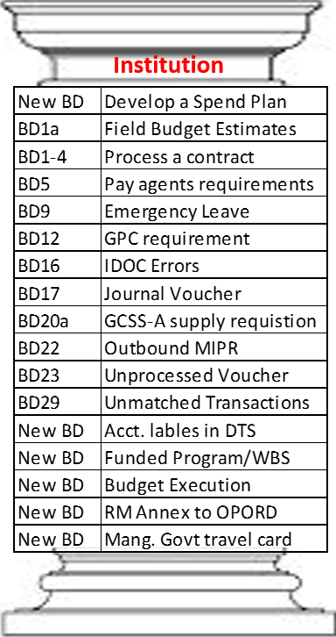
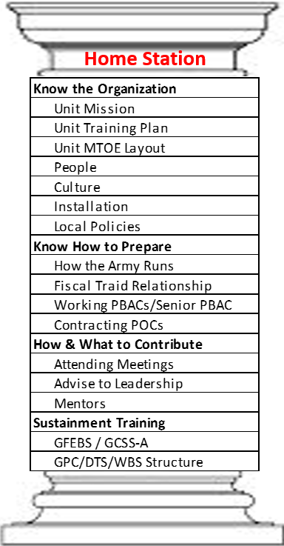
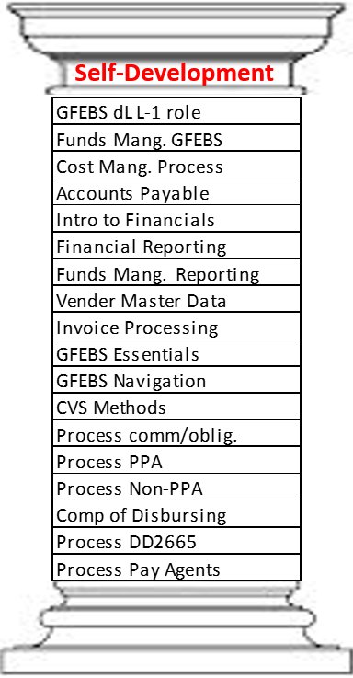
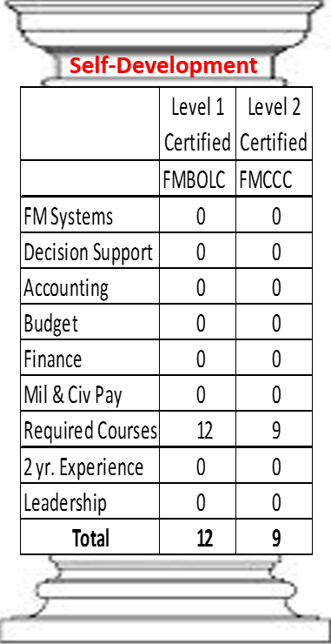
S8 Gunnery Training Formula
(Battle Drills + Home Station Training) + (GFEBS Prov + FM Certification)
Trained, Ready, Agile, and Adaptive Leaders w/ Fund Certification Authority
+
+
METL to Battle Drill Crosswalk
7
Notes:
Show Slide 7: Agenda
The S8 Gunnery Training Formula is the recipe for success. We train company grade financial managers in the art of resource management using approved business processes / battle drills (collective and individual task). These battle drills were not developed in a school house stove pipe environment but developed by getting important feedback from across the FM community…to include hosting a 3 day collaboration workshop in which Corps, Division, Brigade G8’s/S8’s and Department of the Army Civilians to develop and confirm the business process/battle drills. The FM community agreed that with institutional battle drill training, combined with home station training, that “Fund Certification Authority” could indeed be pushed down to the Brigade S8. To that end, Financial Managers now arrive at their units with the necessary tools to provide critical resource management expertise.
Additionally the FMS has taken the responsibility of ensuring that all graduates are provisioned in GFEBS and are Level I and II FM Certified so that Financial Managers arrive at their units fully mission capable and ready to provide an expertise that can only be found in the FM Community.

Slide 8
GFEBS S8– Infantry or
Sustainment Brigade
2 PAX
S8 (O3)
S8 NCOIC (E7/E6)
L305E L210E
L410E
L412E
L413E
L230E
L432E
L435E
L250E
L251E
L450C
L451E
L452E
L453E
L457E
Command Budget Reporter
FMBB
FMMEASURED
CJ20N
WE02
WE09
Z_OPEN_COM – FM Z_OPEN_OB – FM
ZFSC1
ZFSC2
ZFSC3
ZFSC9
ZFSNC1
ZFSNC2
ZFSNC3
VA03
FB03
ME21N
ME22N
ME23N
ME51N
ME52N
ME53N
ZOS_IFV
S_P99_41000147 ZSSC_DD448 ZSSC_PRINT_PR
FV50
FV53
FMAVCR02
ME54N
KO03
ECC Budget Reporter
BI Budget Reporter
Cost Management Reporter
Position
Project Financial Controller
Project Funds Approver
Project Report Reviewer
Project Financial Maintainer
Required
Role
Project Maintainer
Project Schedule Controller
Project Time Processor
Transaction
Code(s)
Project Workflow Monitor
Project Approver
Commitment Processor
Purchase Order Processor
Course(s)
Purchase Requisition Approver
Purchase Requisition Funds Certifier
Purchase Order Processor
Accounts Receivable Reporter
Reimbursable Reporter
Customer Master Data Reporter
Funds Management Maintainer
Financial Reviewer
Customer Order Approver
Journal Voucher Processor
8
Notes:
Show Slide 8: Roles

Slide 9
GFEBS Courses Needed for CPT/SFC in S8
GFEBS Essentials
GFEBS Essentials BI Reporting
L210E Financials Process Overview
L230E Cost Management Process Overview
L250E Acquisition Process Overview
L251E Accounts Payable Process Overview
L410E Introduction to Financials
L412E Journal Entries Processing and Approval
L413E Financial Reporting
L432E Cost Collection and Allocation
L435E Cost Reporting and Analysis
L450C Charge Card Process in GFEBS
L451E Material and Vendor Master Data Maintenance
L452E Purchase Requisitioning and Approval
L453E Purchase Orders and Contracts
L457E Purchase Card
9
Notes:
Show Slide 9: GFEBS Courses

Slide 10
Provisioning
GRC is a web-based application used by the Army to manage access to the GFEBS system. The Army manages GFEBS access using the GRC application to:
Ensure that the people have access to appropriate GFEBS end-user roles
Provide an approval audit trail for end-users that receive access to GFEBS
GRC will manage the list of people who are provisioned with GFEBS roles including accounting, invoicing, and other financial responsibilities for the Army.
10
Notes:
Show Slide 10: Provisioning

Slide 11
GFEBS Crosswalk
021 202010D17 A2ABM 131096QLOG 260B ARMY [GFEBS DRN] 2ABM0008 021001
GFEBS LOA
GFEBS Code | GFEBS Fund Master Data
021 | Department Code
202010D17 | Fund
A2ABM | Fund Center
131096QLOG | Functional Area
260B | G/L / Commitment Item/Cost Element
ARMY | Funded Program or Cost Object
[GFEBS DRN] | GFEBS Assigned Reference Number
2ABM0008 | Cost Object (Cost Center, Internal Order or Work Breakdown Structure (WBS)) Embedded within Cost Master Data
021001 | Agency Accounting ID Code/Fiscal Station Number
11
Notes:
Show Slide 11: GFEBS LOA

Slide 12
Department Code
The department code is a three digit code which identifies the military department or government entity receiving the appropriation.
Examples:
17 Department of the Navy, General Funds (also Marines)
20 Department of the Treasury
21 Department of the Army, General Funds
57 Department of the Air Force, General Funds
96 U.S. Army Corps of Engineers (Civil Works)
97 Office of the Secretary of Defense
12
Notes:
Show Slide 12: Examples of department codes

Slide 13
Fund - Appropriation Symbol
An appropriation is an authorization, by an Act of Congress, to make payments out of the Treasury for specified purposes. These four digits of the “Fund” indicate the Treasury Fund Group to which the accounting classification applies. The digits identify the type of funds or major purpose of the appropriation (the “Color of the money”).
Examples:
2010 Military personnel, Army
2020 Operations and Maintenance, Army (OMA)
2035 Other procurement, Army
2040 Research, Development, Test and Evaluation (RDT&E)
2050 Military Construction
2091 Afghanistan Security Forces Funds
13
Notes:
Show Slide 13: Examples of different appropriation symbols

Slide 14
Fund -Years of Availability
This element represents the amount of Fiscal Years this appropriation is available for the obligation of funds. The amount of years vary based on the Appropriation Symbol and purpose of the funds.
Examples:
Appropriation Symbol:
Typical Years of Availability:
2010 Military Personnel, Army
1 Year
2020 O&M, Army (OMA)
1 Year
2035 OPA
3 Years
2040 RDT&E
2 Years
2050 MILCON
5 Years
2093 Joint IED Defeat Fund
1 Year
14
Notes:
Show Slide 14: Funds and typical years of availability

Slide 15
Fund - Fund Group Designator
This code indicates how this appropriation affects a particular Budget. The code will indicate if the appropriation affects one’s budget directly or if the money utilized will be reimbursed to the managing Budget Activity.
Codes:
D
Direct Funds
F
Reimbursable Funded (FRA)
A
Reimbursable Automatic (ARA)
T
Trust Fund
R
Receipt Account and Deposit Funds
C
Clearing Account
Z
Non-Reportable
15
Notes:
Show Slide 15: Fund Group Designator

Slide 16
Functional Area element Example
131096
1** Operating Forces (OMA- Budget Activity Group 1)
13* Land Forces Readiness
131 Base Operations Support
Army Program Elements under the OMA Appropriation
2** Mobilization (OMA-Budget Activity Group 2)
21* Mobility Operations
211 Strategic Mobility
211000
324000
3** Training and Recruiting (OMA-Budget Activity Group 3)
32* Basic Skills and Advanced Training
324 Training Support
422000
4** Admin. and Service Wide Service Activities (OMA BAG 4)
42* Logistics Operations
422 Central Supply Activities
131096
QLOG
VSCW
Training Range Operations
Management Decision Packages (MDEP)
WSUS
MTOE Unit Equipment Support
QLOG
Logistics Activities
FPDE
Night vision
16
Notes:
Show Slide 16: Functional Areas and MDEP

Slide 17
Commitment Item/Cost Element (Example)
USSGL (General Ledger) Codes
6100
Operating Expenses/Program Costs (most common)
1200
Foreign Currency
1310
Accounts Receivable
6100.
260B
21T0- OpEx/Pgm Costs -TDY Travel
Commitment Items
2320- Rent payments to others
252A- OpEx/Pgm Costs - IT Svcs - Processing
260B- OpEx/PgmCosts-General Supplies, not cat
31C1- General Equipment
17
Notes:
Show Slide 17: Commitment Item/Cost Element

Slide 18
Commitment Item/Cost Element Examples
The highlighted fields indicate data required by GFEBS to process and record transactions against the appropriate OMB Object Class and G/L Code.
.
18
Notes:
Show Slide 18: Commitment Item/Cost Element Examples

Slide 19
Fund Center
The Fund Center contains information about specific organizational elements within the Army that are authorized to receive, distribute, and manage funds. Also referred to as Budget Objects, Fund Centers manage and distribute funds for the costs incurred. Funds Center is a 1- to 11-character data element. The Funds Center structure is hierarchical from the top, with “A” for Army at Level 1 to level 3 or 4. In legacy terms, this element was the Operating Agency (OA) or, in most cases, Allotment Serial Number (ASN).
Funding Hierarchy
A
Appropriation Sponsor (A-Always Army)
76
Operating Agency (OA) (FORSCOM)
C
Region
C
Installation - (Fort Bragg)
19
Notes:
Show Slide 19: Fund Center- Level 1 to level 4 fund centers

Slide 20
Fund Center Examples (Deployed)
A8AAA
ARCENT (U.S. Army Central Command)
A8AAB
CSTS-A (Combined Security Transition Command – Afghanistan)
A8AAC
USFOR-A (United States Forces – Afghanistan)
A8AAD
ASG-KU (Area Support Group Command – Kuwait)
A8AAE
ASG-QA (Area Support Group Command – Qatar)
A8AAG
CFLCC (Combined Force Land Component Command)
20
Notes:
Show Slide 20: Fund Center example

Slide 21
Cost Center
Cost Centers are cost objects in the Controlling Area of GFEBS that reflect an organization’s command and control structure where costs are incurred. The organizational unit can be defined based on functional requirements, allocation criteria, physical location, or responsibility for costs. Cost Centers represent the organization’s hierarchical structure found in its Table of Distribution and Allowance (TDA) or Table of Organization and Equipment (TO&E). Code Center codes replaced Unit Identification Codes (UIC) and may be up to 10 digits long.
Note that the first four digits of the Cost Center match the last four digits of the Funds Center code.
NOTE: GCSS-Army (Global Combat Support System) and other Organizations are yet to adopt this Cost Center format. This will make it difficult to identify who the Cost Center belongs to.
20000843
G1- Fort Bragg
A76CC
76CCMSE
20000844
G2- Fort Bragg
(Fort Bragg)
(US Army Mission Support, Ft. Bragg
20000845
G3- Fort Bragg
21
Notes:
Show Slide 21: Cost Center

Slide 22
GFEBS
ME51N/
FMY1
GFEBS
ME21N/
FMZ1
GFEBS
MIGO/
ML81N
GFEBS
MIRO/
FB60
GFEBS
F110
22
Notes:
Show Slide 22: Procure to Pay (P2P) process
The procure to pay process is the end-to-end business process of requesting goods or services through the vendor payment for good or services.

Slide 23
Check on Learning
What is the difference between master and transactional data?
2. What is the procure to pay (p2p) process?
How are end-users provisioned in GFEBS?
23
Notes:
Show Slide 23: Questions
A1: Master data: A vendor master record contains the vendor’s name, address, and payment terms.
Transaction data: When you create a requisition, GFEBS will create an electronic document for the transaction.
A2: The procure to pay process is the end-to-end business process of requesting goods or services through the vendor payment for good or services.
A3: Provisioning occurs through the web-base application GRC.

Slide 24
Questions?
24
Notes:
Show Slide 24: Questions
Restate TLO and Summarize lesson

