Slide 1
General Funds Enterprise Business System (GFEBS) Navigation Overview
Notes:
Slide 1
SECTION I. ADMINISTRATIVE DATA
Academic Hours / Methods
1 hrs / 00 min Large group Instruction
/ 0 min Practical Exercise (Hands On)
/ 0 min Test
/ 0 min Test Review
1 hrs / 00 min Total Hours
SECTION II. INTRODUCTION: Today we are Reviewing Funds Management
Method of Instruction. Conference / Discussion
Instructor to Student Ratio: 1:24
Time of Instruction 1 hrs 00 mins
Media: Large Group Instruction
Motivator: In today’s Army, we define ourselves as being the best trained, equipped and the best led Army that the United States has ever known. So to keep this image we as Financial Leaders and Managers have to become the best at financially supporting our Soldiers and being stewards of taxpayer dollars. Knowing this we have embraced Standard Financial Information System (SFIS) and the General Fund Enterprise Business System (GFEBS) in that it provides our Army decision makers with accurate, reliable, timely business and financial information to keep our War Fighters within their fiscal responsibilities.
Student Materials:
Student Funds Management PowerPoint slides
Access to AFMS TED 357
Motivator or Lead-in
In this block of instructions we will be covering how to understand who to contact to create data in the source system; define the three primary customer master data processes; describe the importance of and how to use customer master data, how to use customer account groups, the sources of master data (AESIP), and create a Project, create a reimbursable sales and fund it.
Financial Management Technicians are obligated with the task of ensuring our inputted data is accurate, reliable, and useful to others. Knowing all particular requirements and methods utilized in GFEBS will keep technicians and commanders safe.
Knowledge of the concepts and the types/stages of the reimbursement program is essential to learning military accounting. Without this knowledge, you will not be able to follow the flow of transactions inherent to military accounting. As accountants, you must be able to recognize a reimbursement transaction and know how to properly account for those funds used to support a non-mission expense. Funds used to finance non-mission reimbursement transactions are either created, based upon a signed agreement between the performing activity and the receiving activity, or provided by higher command for specific purposes. The installation providing the goods and/or services will be REIMBURSED by the installation receiving the benefit of these goods and/or services. This causes an overall financial effect of zero to the performing installation's records; they use their own funds then collect from the benefiting activity or installation. In either case, the timely and accurate accounting for these funds is essential to ensure that the reimbursement program is being executed within regulatory guidelines. Failure to properly monitor the reimbursement program could result in a violation of US Code 31, Section 1517.
Instructor Note: Insert Concrete experience disk and play ‘Navigate the General Fund Enterprise Business System”
b. Concrete Experience (05 minutes)
The concrete experience serves as a trigger of past experience, knowledge, and it is also a focusing mechanism for the lesson that follows to support the teaching of new content. The collective intent is to force the student to connect to the lesson and is the precursor to intuitive thinking of experiential learning model.
Concrete experience: click on Play
Discuss the bridge between the question and lesson to help the students understand the importance of relating past experience to current situations.
Instructor Note: To open the discussion canvas the class to see how many have deployed. Find out what they did on the deployment.
c. Publish and Process (15 Minutes)
During this phase of the Army Learning Model the instructor will solicit responses of the student’s reaction to the concrete experience. The students will reflect on their experience and knowledge of the topic and they will begin a reconciliation of where they are and, if successful, where they will be at lesson end.
The critical portion of this part of the ALM process is to force the students to reflect. As the instructor you can achieve this by asking a series of thought influencing questions, for example:
What happened in the video/skit/slide and how could it relate to this lesson?
How did it make you feel about the personal responsibility that must be taken to mitigate causing undue hardship to Soldier’s and their Family’s?
What did you hear/see that makes you relate it to your own experiences?
What was your reaction to the magnitude of miscues?
Having the students think critically is the ultimate goal of publish and process. Force the students to explain their answers; meaning, how and why did they arrive at the solution to the questions.
As the instructor, you should also be looking for responses that will help the student’s transition from publish and process to generalize new information. During this process, remind the students of lesson objectives as they transition from publish and process into generalize new information.
Show Slide #2

Slide 2
Terminal Learning Objective
Action:
Perform GFEBS Navigation and understand its functional capabilities.
Conditions:
Given a computer, access to the GFEBS training database, applicable GFEBS references, and various accounts payable documents. .
Standards:
With a minimum of 80% accuracy perform the following:
Explain the purpose of GFEBS
Describe the impact GFEBS has on all Army organizations
Demonstrate how SAP provides the platform for GFEBS
Navigate throughout GFEBS and it’s related sites.
2
Notes:
Slide #2
Action: Define Financials and identify the sub-processes involved in GFEBS. Explain how Financials fits into the GFEBS end-to-end process. Explain how Financials integrates with the other GFEBS business process areas.
Conditions: Given a computer, access to the GFEBS training database, applicable GFEBS references, and standard office supplies.
Standards: With a minimum of 80% accuracy, correctly define Financials and identify the sub-processes involved in GFEBS.
SAFETY REQUIREMENTS: In a training environment, leaders must perform a risk assessment in accordance with FM 5-19, Composite Risk Management. Leaders will complete a DA Form 7566 COMPOSITE RISK MANAGEMENT WORKSHEET during the planning and completion of each task and sub-task by assessing mission, enemy, terrain and weather, troops and support available-time available and civil considerations, (METT-TC). Note: During MOPP training, leaders must ensure personnel are monitored for potential heat injury. Local policies and procedures must be followed during times of increased heat category in order to avoid heat related injury. Consider the MOPP work/rest cycles and water replacement guidelines IAW FM 3-11.4, NBC Protection, FM 3-11.5, CBRN Decontamination.
RISK ASSESSMENT LEVEL: Low
ENVIRONMENTAL STATEMENT: Environmental protection is not just the law but the right thing to do. It is a continual process and starts with deliberate planning. Always be alert to ways to protect our environment during training and missions. In doing so, you will contribute to the sustainment of our training resources while protecting people and the environment from harmful effects. Refer to FM 3-34.5 Environmental Considerations and GTA 05-08-002 ENVIRONMENTAL-RELATED RISK ASSESSMENT.
EVALUATION. You will be given an exam which will include Review Detailed Expenditure Accounting Documents. A passing score on this examination is 80% and for International Students (80%).
INSTRUCTIONAL LEAD IN - Before we can understand how to control our funds, we must briefly discuss how funds are received.
Show Slide #3

Slide 3
Concepts
What is General Funds Enterprise Business System
(GFEBS)?
A web-based financial, asset, and accounting management system that provides the Army relevant, reliable, and timely financial information
GFEBS will standardize and streamline financial business processes
GFEBS is deployed to over 200 locations and support more than 79,000 end-users
GFEBS integrates several different modules to access the same database and use the same master data. Master data includes vendors, functional locations, etc.
Notes:
Show Slide #2
What is General Funds Enterprise Business System (GFEBS)?
A web-based financial management system that provides the Army relevant, reliable, and timely financial information .
GFEBS results in a multitude of benefits for the Army’s financial professionals. Currently, the Army spends a large percentage of its efforts processing transactions, controlling interfaces and generating reports.
With GFEBS, the Army’s financial professionals are now able to devote more time to financial analysis and reduce the amount of time spent on processing transactions.

Slide 4
Purpose
Provide decision support information to sustain Army war fighting capability
Provide analytic data and tools to support Institutional Adaptation
Reduce the cost of business operations
Improve accountability and stewardship
Enable decision-makers across the Army to –
Better capitalize on the resources we have
Better determine and justify the resources we need
Notes:
Show Slide #3
The primary objectives are to improve performance, standardize business processes and ensure capability exists to meet future needs.
The primary goal of GFEBS is to capture transactions and provide reliable data to better enable Army leadership to make decisions in support of the War fighting capability in era of persistent conflict.
GFEBS results in a multitude of benefits for the Army’s financial professionals. GFEBS enables the Army’s financial professionals to realize wide-ranging benefits as the system is incrementally deployed throughout the Army, including the following:
Customized reporting
Electronic data interchange
Electronic document routing
Online analysis
Online suspense tracking
Workflow processing
Interactive document entry
Web interfaces
GFEBS will require significant integration with other systems to support installation or activity level, major command, and departmental accounting, finance, cost and reporting operations.

Slide 5
System Overview
Active Army
Army National Guard
Army Reserve
Transactions
GFEBS is organized for reports, analysis and development activities into 6 functional areas.
All users across the Army draw common data from and record transactions in the Enterprise Central Component (ECC) (Real-Time).
Periodically, data is transferred from the real-time ECC to the business warehouse, Business Intelligence (BI), which also includes analytic and reporting capabilities.
BI
GFEBS has the ability to process a million transactions a day
As of 20 May 2009
Notes:
Show Slide #4
GFEBS streamlines and shares critical data across the Active Army, the Army National Guard and the Army Reserve.
GFEBS organized analysis and development activities into 9 business processes
All users across the Army draw common data from and record transactions on the central ERP. All input from transactions is simultaneously available to all related actions.
All data is available in the Business Intelligence module for analyses and support decision-making across the staffs and the Army.

Slide 6
GFEBS Modules
GFEBS is an Enterprise Resource Planning (ERP) solution consisting of integrated functional modules.
FI
FI - Financials
FM - Funds Management
SC - Spending Chain
CM - Cost Management
RM - Reimbursables
EA - Equipment and Assets
PS - Project Systems
RP - Real Property
PM - Plant Maintenance
FM
SC
GFEBS
PM
CM
RP
RM
PS
EA
Notes:
Show slide #5
GFEBS is an Enterprise Resource Planning (ERP) solution consisting of integrated functional modules.
There are 9 Business Process systems the Army use, they are as follows:
FI - Financials
FM - Funds Management
SC - Spending Chain
CM - Cost Management
RM - Reimbursables
EA - Equipment and Assets
PS - Project Systems
RP - Real Property
PM - Plant Maintenance

Slide 7
Overview
Two primary types of data exist in GFEBS
Master data is information about a person or an object, such as a cost object, vendor, or (general ledger) G/L account. For example, a vendor master record contains the vendor’s name, address, and payment terms. Using master data helps users to avoid data redundancy. GFEBS populates the header fields with saved master data information.
Transactional data is transaction-specific data that is associated with master data. Transactional data is created from a single business event such as a purchase requisition or a request for payment. When you create a requisition, for example, GFEBS will create an electronic document for the transaction.
Notes:
Show Slide #6
Two primary types of data exist in GFEBS: Master Data and Transactional Data.
Integrating master data through a single source such as GFEBS eliminates data redundancy and conflicting information, and provides a single view of master data information.
The general ledger is the main accounting record of a business which uses double-entry bookkeeping. It will usually include accounts for such items as current assets, fixed assets, liabilities, revenue and expense items, gains and losses.
We will discuss Customer Master Data later in one of the learning activities.

Slide 8
Roles
A role is defined as a major grouping of activities that
reflect a specific aspect of a person’s job. While a role may
have several activities aligned to it, an activity can only be
aligned with one role.
Notes:
Show slide #7
A role is defined as a major grouping of activities that reflect a specific aspect of a person’s job. While a role may have several activities aligned to it, an activity can only be aligned with one role.
GFEBS roles determine what activities an end user performs when using the system, what sections of the system an end user has access to, and what training an end user needs to perform their new roles successfully.
A person may be assigned one or more roles, and roles can be assigned to one or more persons.
Note: There should be a separation of duty amongst the roles to prevent fraud and abuse, etc.
For example: A processor should not have the role of a certifier or approver.

Slide 9
GFEBS Navigation Overview Continued
8
Notes:
Show Slide #8

Slide 10
Transactions Codes (T-Codes)
To access various transactions within GFEBS, users must enter transaction codes in the Command Field
T- Codes are a sequence of characters that identifies a transaction or function in GFEBS
T-Codes allow the user to perform their various job functions in GFEBS
Notes:
Show Slide #9
To access various transactions within GFEBS, users must enter transaction codes in the Command Field
T- Codes are a sequence of characters that identifies a transaction or function in GFEBS
Basically, T-Codes allow the user to perform their various job functions in GFEBS
We will use a VA01 (Create a sales order)

Slide 11
Transactions Codes (T-Codes)
The action part of the Transaction Codes (T-Codes) allow the user roles to perform the following functions:
Create (01)
Change (02)
Display (03)
Run reports
These functions allow the flexibility of daily tasks performed and is also instrumental in Job Role Mapping
Notes:
Show Slide #10
An SAP specific, unique command that tells the location of a system task. A transaction code may contain letters only or a combination of letters and numbers. When entered into the command line in SAP, the system is prompted to perform specific tasks The action part of the T-Codes allow the user roles to perform the following functions:
Create (01)
Change (02)
Display (03)
Run reports
These functions allow the flexibility of daily tasks performed and is also instrumental in Job Role Mapping
Relate the T-codes to the Format ID and Action codes. For example a 3501 (start BAH) 4003 (report BAS). Ensure they understand the different codes: a 01, 02, and 03 difference using DJMS and GFEBS.

Slide 12
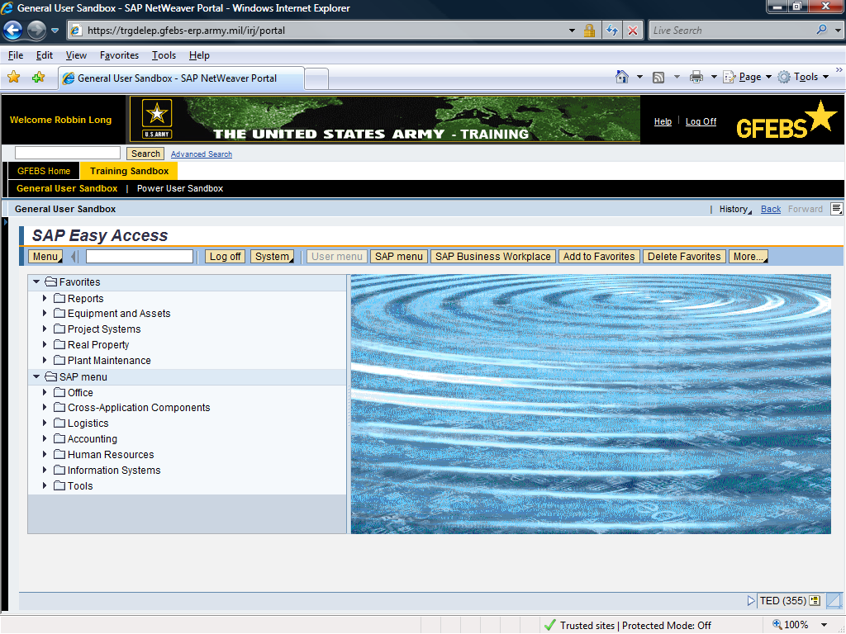
VA01
11
Notes:
Show Slide# 11
Type in a T-code. We used VA01 Create a sales order

Slide 13
SAP Easy Access Menu Screen Elements
Command Field
1
Add to Favorites Button
Menu Button
13
Notes:
Show Slide #12
The Menu Button can be used to drill down to different areas within the system.
Command Field: Used for T-codes and additional codes to maneuver through GFEBS
Add to Favorites: You can save the T-codes you utilize on a regular basis. You are not limited to what you can save in your favorites folder. By saving your T-codes you can access your t-codes faster than you can using drill down procedures.
Favorites
Favorites are a saved reference in the form of a link to a particular function, location, or site. To add a favorite, you must locate the transaction you would like to save from the menu path on the GFEBS Portal Home Screen.
Adding Favorites
To add a transaction to your Favorites folder, drill into the menu path on the GFEBS Portal Home Screen. Select and highlight the transaction and click the button. Review the following screen shot that highlights how to add a favorite.
After you have saved the transaction to your favorites, you can edit the name by right clicking on the transaction you want to change. A drop down will appear, select “Change Favorites” and you can personalize your favorite.

Slide 14
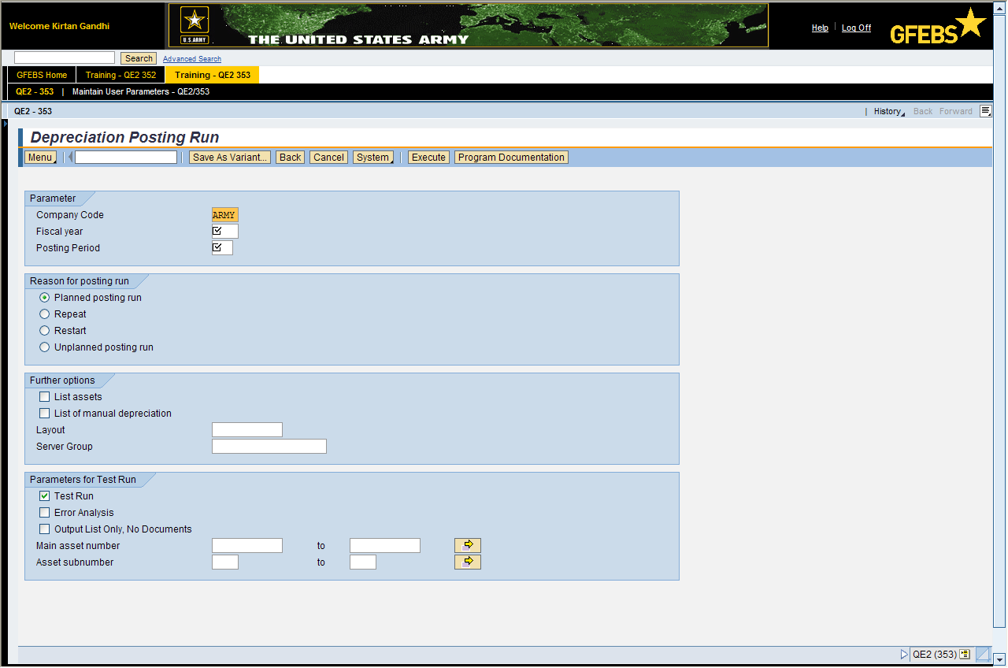
Help / Logging Off
General Help and Logging Off
F1 Field Explanation
Log off link
Help Link to Access the Performance Support Website
Notes:
Show Slide #13
Help link will take you to the Performance Support Website (PSW). This will be addressed later in this block of instructions.
Logoff – select this button to logoff or close out GFEBS.

Slide 15
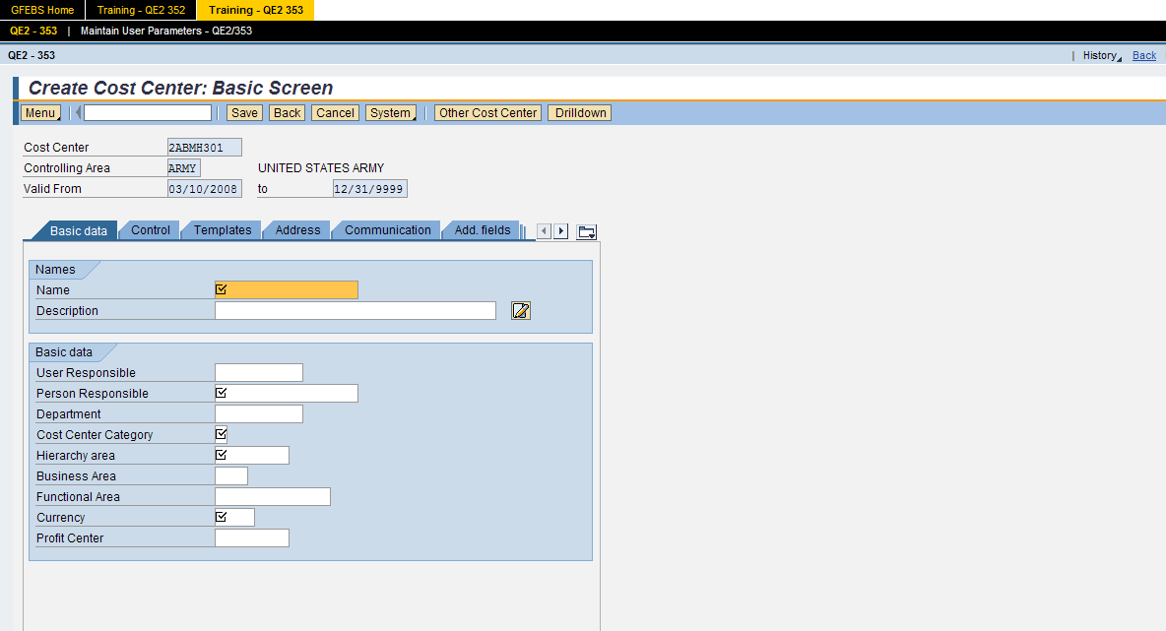
GFEBS Screen Elements
Navigation Tabs
Fields
Some Tabs and Fields are not used due to cost effectiveness
15
Notes:
Show Slide #14
Navigation Tabs will take you to certain screens that need to be filled based on the T-code and user role you need at the time of input. There are different navigation tabs that display on the screen based on the t-codes or reports you are requesting.
Fields are used to input information needed for the T-codes.

Slide 16
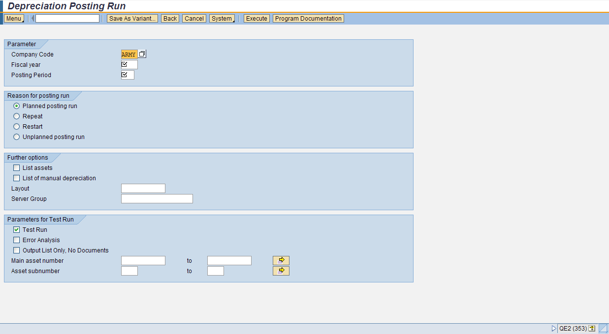
Input Fields
Required, Optional and Conditional
For additional Field Information click in the field and press F1
Required Fields
Optional Fields
Conditional Fields
16
Notes:
Show Slide #15
There are 3 types of data entry fields:
Required Fields = R
Optional Fields = O
Conditional fields = C
The R/O/C column in the field description table represents the three types of data entry fields in SAP.
· R is for required fields that must be populated to complete a transaction.
· O is for optional fields that are not mandatory to complete a transaction.
· C is for conditional fields that are dependent on population of related fields and specific transactional events. On certain screens you may need to scroll to view additional data fields.
You will see these data entry fields when you utilize the user procedures and job aides within the PSW and Milwiki.
During the GFEBS training we will use only the Required Fields. Your unit policies or supervisor will designate what fields will be used for that location.

Slide 17
Radio Buttons and Checkboxes
Radio Buttons
Checkboxes
Notes:
Show Slide #16
Radio buttons offer a single select, while check boxes offer a multiple select

Slide 18
Status Bar System Messages
Status Bar
The Status bar is located on the lower left corner of the screen. It displays information such as warning and error messages. There are three different types of status messages. Review the message types listed below.
Message Type Description
Error Message - Messages indicating incorrect entry in the system such as required or inaccurate data. You will not be able to continue with your transaction until these messages are addressed.
Info Message - Affirmative system message or messages displaying information on a transaction.
Warning Message - Messages that identify information that may possibly be an error. These messages may or may not allow you to continue with your transaction, depending on its function within the system.
Notes:
Show Slide #17
Status Bar
The Status bar is located on the lower left corner of the screen. It displays information such as warning and error messages. There are three different types of status messages. Review the message types listed below.
Message Type Description
Error Message - Messages indicating incorrect entry in the system such as required or inaccurate data. You will not be able to continue with your transaction until these messages are addressed. PE answer
Info Message - Affirmative system messages or messages displaying information on a transaction.
Warning Message - Messages that identify information that may possibly be an error. These messages may or may not allow you to continue with your transaction, depending on its function within the system.

Slide 19
Status Bar System Messages
Message Type | Symbol
Error
Information
Warning
Notes:
Show Slide #18

Slide 20
Wildcard Characters
Using Wildcard Characters
Performing wildcard search will increase system performance since fewer records will be pulled from the system. Here are some examples of using a Wildcard search:
Placing the * at the end of a string causes the system to return all records that begin with the letters before the *.
Placing the * at the beginning of a string, the system will find all records that contains the characters at the end.
If you place the * at the beginning and end of the string, the system returns all records that contain the string at the beginning, middle, and/or end.
Notes:
Show Slide #19
Using Wildcard Characters
Performing wildcard search will increase system performance since fewer records will be pulled from the system. Here are some examples of using a Wildcard search:
Placing the * at the end of a string causes the system to return all records that begin with the letters before the *.
Placing the * at the beginning of a string, the system will find all records that contains the characters at the end.
If you place the * at the beginning and end of the string, the system returns all records that contain the string at the beginning, middle, and/or end.

Slide 21
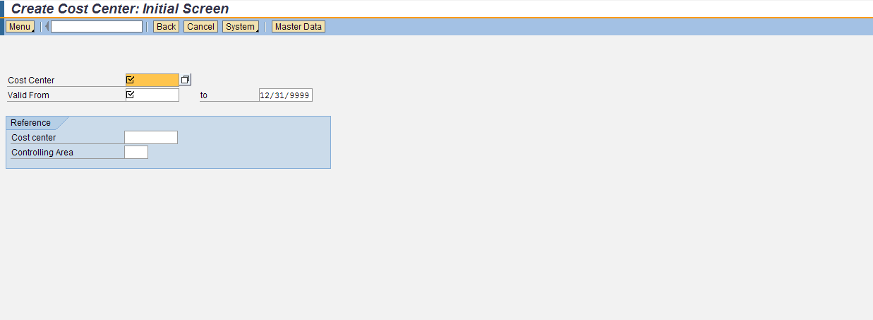
Matchcodes
Matchcodes allow users to select or search for a value from a list.
Matchcode Icon
Wildcard Characters
21
Notes:
Show Slide #20
Using Matchcodes to search for data Matchcodes allow users to select or search for a value from a list.

Slide 22
Check On Learning
Q. What are 3 types of data entry fields?
A. Required Fields = R, Optional Fields = O, and Conditional fields = C
Q. Radio buttons offer a single selection, while ________ offers a multiple selection.
A. Check boxes
Q. What allow users to select or search for a value from a list?
A. Match code
Q. Which selection listed below is used for actual inputs into the live GFEBS system?
GFEBS GRC
GFEBS Portal
GFEBS Training and Performance support Website
GFEBS Training Portal
Notes:
Show Slide #21

Slide 23
Hands-on Navigation
Notes:
Show Slide #22
Note: Walk students through the hands-on portions of navigation:
Adding GFEBS to favorites
PSW
User Procedure
Training Guide
Concept Slide
milWiki – finding job adds
Milbook – military version of face book.
Training Sandbox (Training Portal TED 357)
Public Folders

Slide 24
Terminal Learning Objective
Action:
Perform GFEBS Navigation and understand it’s functional capabilities.
Conditions:
Given a computer, access to the GFEBS training database, applicable GFEBS references, and various accounts payable documents. .
Standards:
With a minimum of 80% accuracy perform the following:
Explain the purpose of GFEBS
Describe the impact GFEBS has on all Army organizations
Demonstrate how SAP provides the platform for GFEBS
Navigate throughout GFEBS and it’s related sites.
Notes:
Slide #23
Instructor Notes: Solicit questions the students may have, summarize, and restate TLO
Show Slide #24

