Slide 1
Communicate GFEBS Overview
Notes:
SHOW SLIDE 1: Communicate General Fund Enterprise Business System (GFEBS) Overview
References: DFAS-IN-MANUAL 37-100 & FM 1-06
Section I. Administrative Data
Academic Hours/Methods
01 hrs. / 00 min. DSL (small or large group discussion)
02 hrs. / 20 min. PE (Practical Exercise)
00 hrs. / 00 min. Test
00 hrs. / 00 min. Test Review
03 hrs. / 20 min. Total Hours
Section II. Introduction:
Method of Instruction: DSL - Discussion (large or small group)
Facilitator's to Learner Ratio: 1:30
Time of Instruction: 00 hrs. / 05 min.
Media: PowerPoint Presentation
Facilitator Material: Each primary facilitator should possess a lesson plan, evaluation sheet, scenario event list for exercises, and summary sheet containing the above noted references.
Learners Material: Learners should possess course handouts, access to all systems for exercises, summary sheet containing the above noted references portable laptop, and standard classroom supplies.
Instructional Guidance: Incorporate the political, military, economic, social, information, infrastructure, and physical environment and time (PMESII&PT) into each lesson and classroom work as appropriate. Instructor will illustrate them with appropriate examples from the Current Operating Environment (COE) as it pertains to the lesson.
Motivator (Concrete Experience): The journey of a thousand miles begins with a single step. This navigational lesson in SAP and GFEBS overview is that step for a Financial Manager or Budget Analyst. In this lesson, we will familiarize you with the very basics in language, applications, and references needed to set the GFEBS user up for success upon completion of this course.

Slide 2
A C T I O N
Communicate GFEBS Overview
FC Leaders in a classroom environment working individually or as a member of a small group, using DFAS-IN Manual 37-100, FM 1-06, self-study exercises, personal experiences, practical exercises, handouts, and discussion.
C O N D I T I O N
- Communicate the goals of GFEBS in a clear and concise manner and without error
- Communicate the SAP platform for GFEBS without error
S T A N D A R D
2
Notes:
SHOW SLIDE 2: Terminal Learning Objective
Facilitator’s Note: Read/State the TLO
Safety Requirement: In a training environment, leaders must perform a risk assessment in accordance with DA PAM 385-30, Risk Management. Leaders will complete a DD Form 2977 RISK MANAGEMENT WORKSHEET during the planning and completion of each task and sub-task by assessing mission, enemy, terrain and weather, troops and support available-time available and civil considerations, (METT-TC). Local policies and procedures must be followed during times of increased heat category in order to avoid heat related injury. Consider the work/rest cycles and water replacement guidelines IAW TRADOC Regulation 350-29.
Risk Assessment Level: Low.
Environmental Considerations: Environmental protection is not just the law but the right thing to do. It is a continual process and starts with deliberate planning. Always be alert to ways to protect our environment during training and missions. In doing so, you will contribute to the sustainment of our training resources while protecting people and the environment from harmful effects. Refer to FM 3-34.5 Environmental Considerations and GTA 05-08-002 ENVIRONMENTAL-RELATED RISK ASSESSMENT.
Evaluation: Learners will take a test following week 1 and week 2. Learners must score 80% or higher to obtain a passing score.
Instructional Lead-in: In order to understand the GFEBS system of financial auditability and accountability, we must first become familiar with the SAP system, its language, and the vast capabilities it serves through millions of transactions per day across the globe. It is literally the first step in the thousand mile journey.

Slide 3
Describe GFEBS Concepts
What is General Fund Enterprise Business System (GFEBS)?
A web-based financial, asset, and accounting management system that provides the Army relevant, reliable, and timely financial information
GFEBS standardizes and streamlines financial business processes
GFEBS has been deployed to over 200 locations, supporting thousands of end-users
GFEBS integrates several different modules to access the same database and use the same master data. Master data includes vendors, functional locations, etc.
Notes:
SHOW SLIDE 3: Describe GFEBS Concepts
Section III. Presentation.
Learning Step / Activity 1. Communicate the Concepts and Goals of GFEBS
Method of Instruction: DSL (large or small group discussion)
Facilitator's to Learner Ratio: 1:25
Time of Instruction: 01 hrs. / 30 min.
Media: PowerPoint Presentation, Handout
Facilitator’s Note:
What is General Fund Enterprise Business System (GFEBS)?
A web-based financial management system that provides the Army relevant, reliable, and timely financial information .
GFEBS results in a multitude of benefits for the Army’s financial professionals. Currently, the Army spends a large percentage of its efforts processing transactions, controlling interfaces and generating reports.
With GFEBS, the Army’s financial professionals are now able to devote more time to financial analysis and reduce the amount of time spent on processing transactions.
GFEBS was implemented into the Army in 8 waves, with wave 8b the last phase for Operations (deployed environment) completing the full GFEBS deployment on 1 July 2012.

Slide 4
Goals
Provide decision support information to sustain Army Warfighting capability
Provide analytic data and tools to support Institutional Adaptation
Reduce the cost of business operations
Improve accountability and stewardship
Notes:
SHOW SLIDE 4: Goals
The primary objectives are to improve performance, standardize business processes and ensure capability exists to meet future needs.
The primary goal of GFEBS is to capture transactions and provide reliable data to better enable Army leadership to make decisions in support of the Warfighting capability in era of persistent conflict.
GFEBS results in a multitude of benefits for the Army’s financial professionals. GFEBS enables the Army’s financial professionals to realize wide-ranging benefits as the system is incrementally deployed throughout the Army, including the following:
Customized reporting
Electronic data interchange
Electronic document routing
Online analysis
Online suspense tracking
Workflow processing
Interactive document entry
Web interfaces
GFEBS provides the Army with the capability to integrate across its financial systems and among other domains; GFEBS integrates over 80% of the financial capabilities of the Army. This integration allows for a single data entry into the system – significantly decreasing the number of manual reconciliations performed throughout the Army. Integration also improves planning, programming, budgeting and execution through the use of integrated output data from financial and non-financial sources.
GFEBS requires significant integration with other systems to support installation or activity level, major command, and departmental accounting, finance, cost and reporting operations.

Slide 5
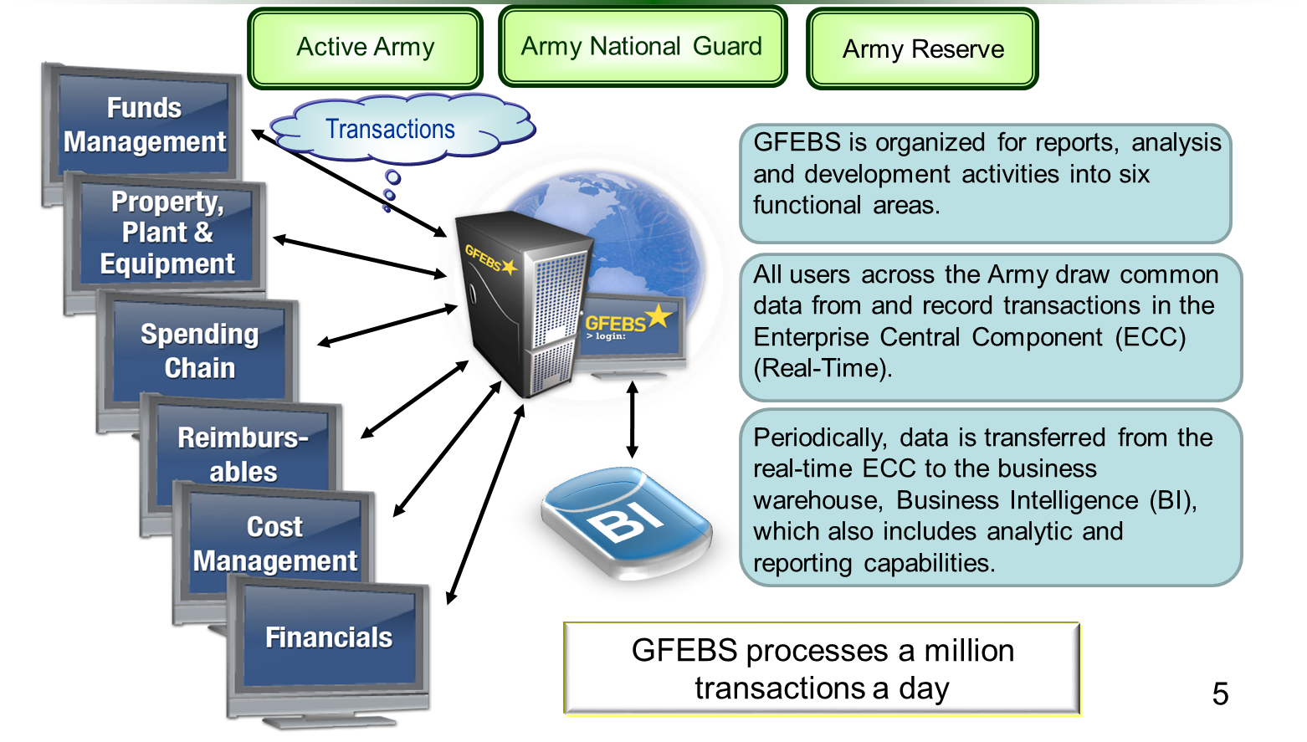
System Overview
Notes:
SHOW SLIDE 5: System Overview
GFEBS streamlines and shares critical data across the Active Army, the Army National Guard and the Army Reserve.
GFEBS organized analysis and development activities into nine business processes
All users across the Army draw common data from and record transactions on the central ERP. All input from transactions is simultaneously available to all related actions.
All data is available in the Business Intelligence module for analysis and support decision-making across the staffs and the Army.

Slide 6
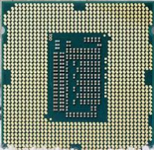
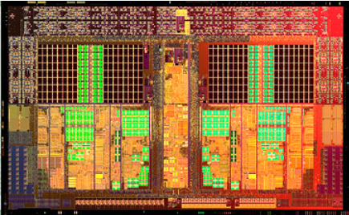
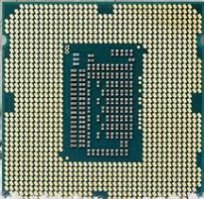
GFEBS Modules
FI - Financials
PM
FI
FM – Funds Management
SC – Spending Chain
CM – Cost Management
RP
FM
RM - Reimbursables
EA – Equipment and Assets
PS
PS – Project Systems
SC
RP – Real Property
EA
RM
CM
PM – Plant Maintenance
GFEBS is an Enterprise Resource Planning (ERP) solution consisting of integrated functional modules.
Notes:
SHOW SLIDE 6: GFEBS Modules
GFEBS is an Enterprise Resource Planning (ERP) solution consisting of integrated functional modules.
There are 9 Business Process systems the Army use, they are as follows:
FI – Financials – Main account for balancing General Ledger, Journal Vouchers, Period/Year End…
FM - Funds Management – The flow of funds, how each organization gets it funding
SC - Spending Chain – Procurement of Goods/Services...
CM - Cost Management – Tracking the cost
RM – Reimbursables – Receiving funds in receipt of Goods or Services
EA - Equipment and Assets – Equipment pricing/value of
PS - Project Systems – Project building
RP - Real Property – Value of property/Depreciations
PM - Plant Maintenance - Operational cost, work/job orders/plans

Slide 7
Overview
Two primary types of data exist in GFEBS
Master data is information about a person or an object, such as a cost object, vendor, or (general ledger) G/L account. For example, a vendor master record contains the vendor’s name, address, and payment terms. Using master data helps users to avoid data redundancy. GFEBS populates the header fields with saved master data information.
Notes:
SHOW SLIDE 7: GFEBS Overview
Two primary types of data exist in GFEBS: Master Data and Transactional Data.
Integrating master data through a single source such as GFEBS eliminates data redundancy and conflicting information, and provides a single view of master data information.
The General Ledger is the main accounting record of a business which uses double-entry bookkeeping. It will usually include accounts for such items as current assets, fixed assets, liabilities, revenue and expense items, gains and losses.
We will discuss Customer Master Data later in one of the learning activities.

Slide 8
Overview (Cont.)
Two primary types of data exist in GFEBS
Transactional data is transaction-specific data that is associated with master data. Transactional data is created from a single business event such as a purchase requisition or a request for payment. When you create a requisition, for example, GFEBS will create an electronic document for the transaction.
Notes:
SHOW SLIDE 8: GFEBS Overview Cont.

Slide 9
Roles
A role is defined as a major grouping of activities that reflect a specific aspect of a person’s job. While a role may have several activities aligned to it, an activity can only be aligned with one role.
Notes:
SHOW SLIDE 9: Roles
A role is defined as a major grouping of activities that reflect a specific aspect of a person’s job. While a role may have several activities aligned to it, an activity can only be aligned with one role.
GFEBS roles determine what activities an end user performs when using the system, what sections of the system an end user has access to, and what training an end user needs to perform their new roles successfully.

Slide 10
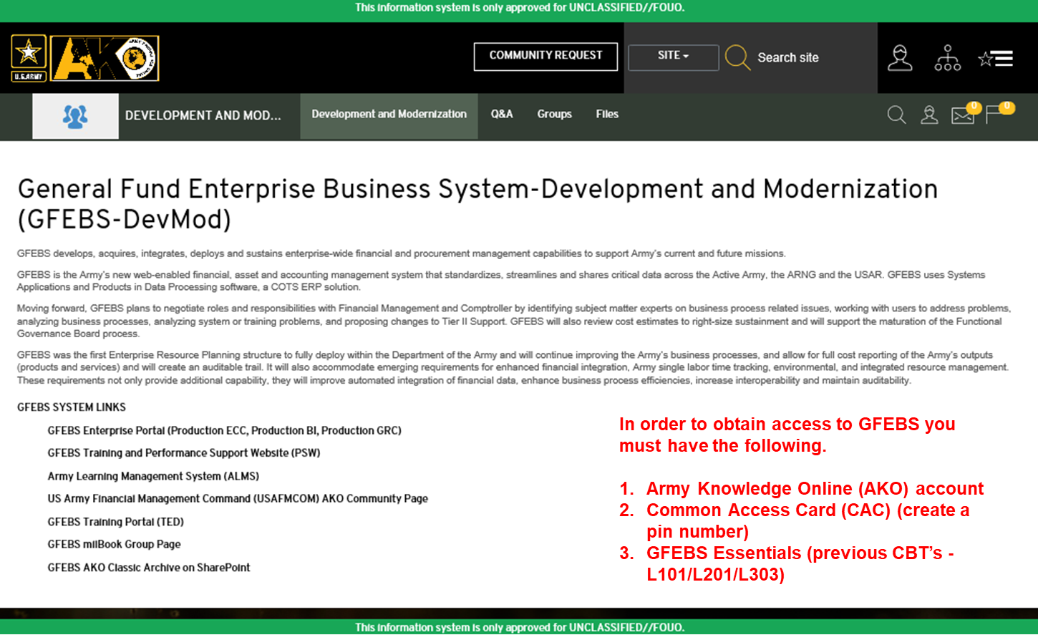
Access to GFEBS
Notes:
SHOW SLIDE 10: AKO Homepage
Prepare students for the step-by-step process to navigate in GFEBS.
In order to obtain access to GFEBS you must have the following:
Army Knowledge Online (AKO) account
Common Access Card (CAC) (create a pin number)
GFEBS Essentials (old CBT’s L101/L201/L303) courses (common core)
In order to be provisioned you must take the required CBT’s. The website for AKO is www.us.army.mil
The GFEBS training approach includes four delivery methods:
Instructor-led Training (ILT), delivered by an instructor in a classroom during a pre-defined training schedule.
Virtual Instructor-led Training (vILT), which is delivered by a remote instructor to students at their home location or at their desks during a pre-defined training schedule;
Computer-based Training (CBT), also known as Web-based Training, accessible via Army Learning Management System (ALMS), and Train-the-Trainer (T3), which trains site
personnel to deliver just-in-time training on business processes that will not be used for a protracted time after go-live.
Distance Learning (DL) and On the Job Training (OJT). OTJ’s are additional ways to receive the training.

Slide 12
Q. GFEBS is organized for reports, analysis, and development activities within 6 functional areas, what are they?
Q. What must you have in order to access GFEBS?
12
Notes:
SHOW SLIDE 12: Check on Learning

Slide 13
Transactions Codes (T-Codes)
To access various transactions within GFEBS, users must enter transaction codes in the Command Field
T- Codes are a sequence of characters that identifies a transaction or function in GFEBS
T-Codes allow the user to perform their various job functions in GFEBS
Notes:
SHOW SLIDE 13: Transactions Codes (T-Codes)
Facilitator’s Note:
To access various transactions within GFEBS, users must enter transaction codes in the Command Field.
T- Codes are a sequence of characters that identifies a transaction or function in GFEBS.
Basically, T-Codes allow the user to perform their various job functions in GFEBS.
We will use an ME51N (Create a Purchase Requisition)

Slide 14
Transactions Codes (Cont.)
The action part of the Transaction Codes (T-Codes) allow the user roles to perform the following functions:
Create (01)
Change (02)
Display (03)
Run reports
These functions allow the flexibility of daily tasks performed and is also instrumental in Job Role Mapping
Notes:
SHOW SLIDE 14: Transaction Codes (Cont.)
Facilitator’s Note:
An SAP specific, unique command that tells the location of a system task. A transaction code may contain letters only or a combination of letters and numbers. When entered into the command line in SAP, the system is prompted to perform specific tasks The action part of the T-Codes allow the user roles to perform the following functions:
Create (01)
Change(02)
Display (03)
Run reports
These functions allow the flexibility of daily tasks performed and is also instrumental in Job Role Mapping
Relate the T-codes to the Format ID and Action codes. For example a 3501 (start BAH) 4003 (report BAS). Ensure they understand the different codes: a 01, 02, and 03 difference using DJMS and GFEBS.

Slide 15
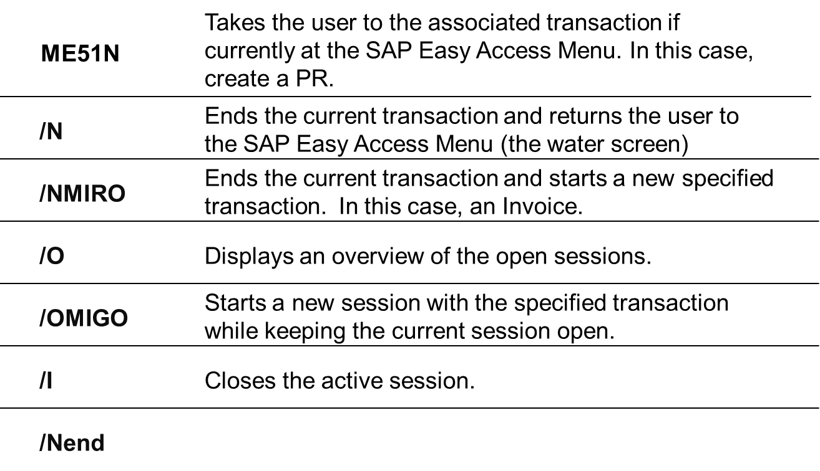
Transactions & Command Codes
Notes:
SHOW SLIDE 15: Transactions & Command Codes
Facilitator’s Note: The following are transaction codes that are standard in SAP / GFEBS:
ME51N - Takes the user to the associated transaction if currently at the SAP Easy Access Menu. In this case, create a PR.
/N - Ends the current transaction and returns the user to the SAP Easy Access Menu (the water screen)
/NMIRO - Ends the current transaction and starts a new specified transaction. In this case, an Invoice.
/O - Displays an overview of the open sessions.
/OMIGO - Starts a new session with the specified transaction while keeping the current session open.
NOTE: /OMIGO (The training client does not allow this; however, production has this capability.)
/I - Closes the active session
/Nend - Ends the current transaction and prompts the user to log off SAP.

Slide 16
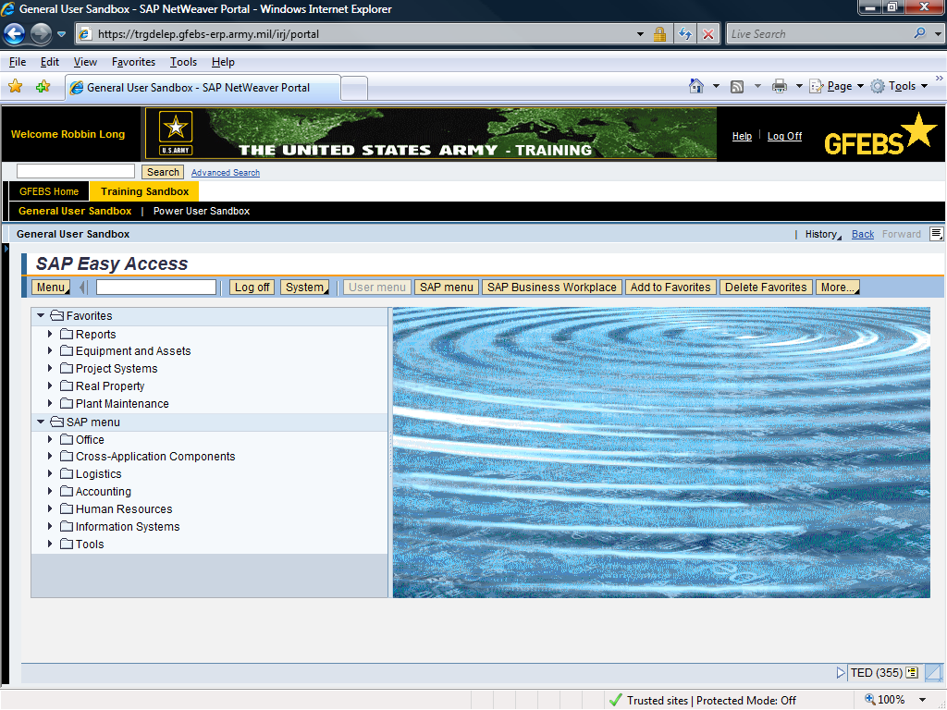
Transaction Code
Your Name
ME51N
Notes:
SHOW SLIDE 16: GFEBS Command-Line
Facilitator’s Note:
Type in a T-code. We used ME51N to create a purchase request

Slide 17
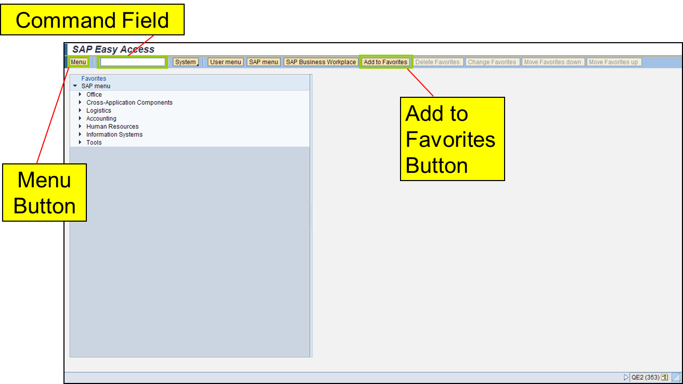
SAP Easy Access Menu Screen Elements
Notes:
SHOW SLIDE 17: SAP Easy Access Menu Screen Elements
The Menu Button can be used to drill down to different areas within the system.
Command Field: Used for T-codes and additional codes to maneuver through GFEBS
Add to Favorites: You can save the T-codes you utilize on a regular basis. You are not limited to what you can save in your favorites folder. By saving your T-codes you can access your t-codes faster than you can using drill down procedures.
Favorites
Favorites are a saved reference in the form of a link to a particular function, location, or site. To add a favorite, you must locate the transaction you would like to save from the menu path on the GFEBS Portal Home Screen.
Adding Favorites
To add a transaction to your Favorites folder, drill into the menu path on the GFEBS Portal Home Screen. Select and highlight the transaction and click the button. Review the following screen shot that highlights how to add a favorite.
After you have saved the transaction to your favorites, you can edit the name by right clicking on the transaction you want to change. A drop down will appear, select “Change Favorites” and you can personalize your favorite.

Slide 18
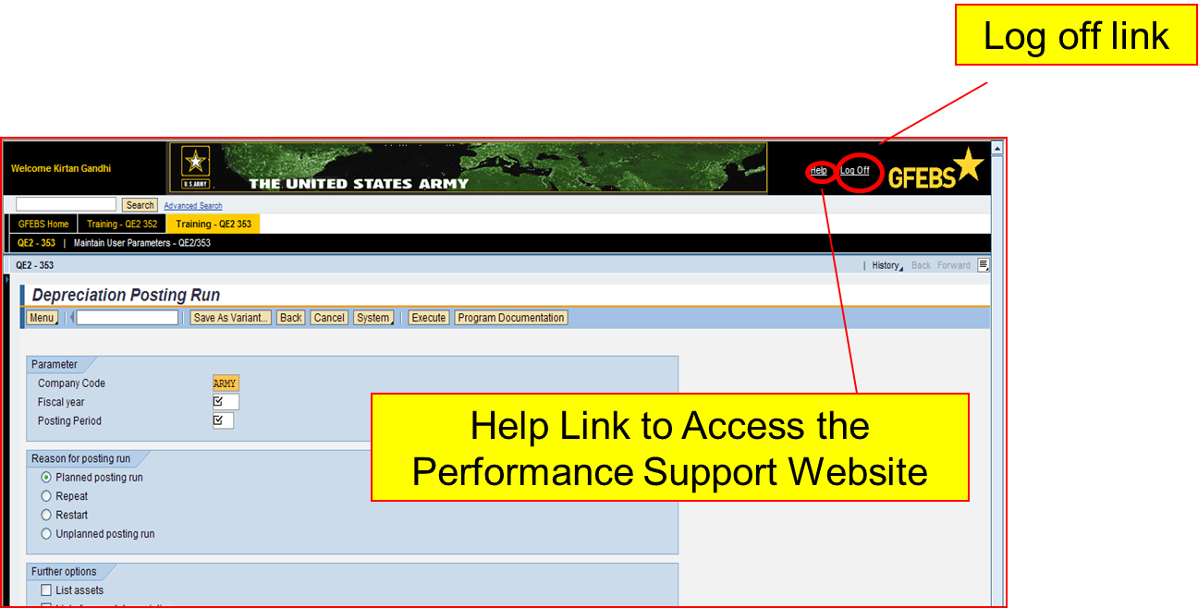
Help / Logging Off
Notes:
SHOW SLIDE 18: Help / Logging Off
Facilitator’s Note:
Help link will take you to the Performance Support Website (PSW). This will be addressed later in this block of instructions.
Logoff – select this button to logoff or close out GFEBS.

Slide 19
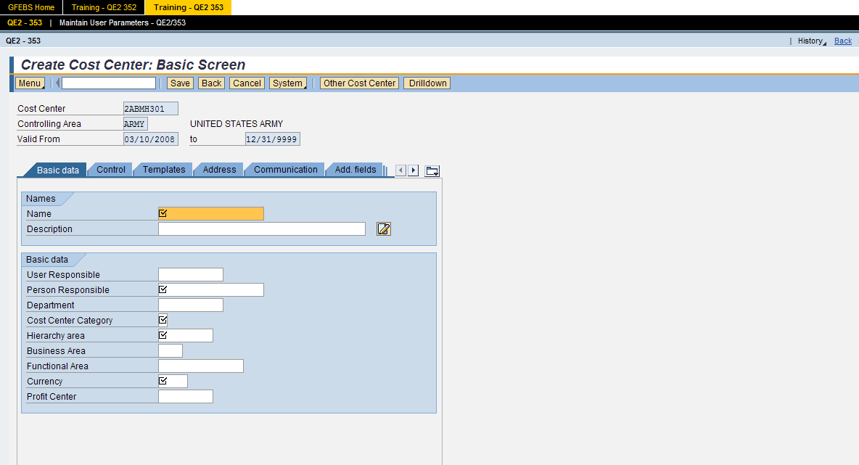
GFEBS Screen Elements
Navigation Tabs
Fields
Some Tabs and Fields are not used due to cost effectiveness
Notes:
SHOW SLIDE 19: GFEBS Screen Elements
Facilitator’s Note:
Navigation Tabs will take you to certain screens that need to be filled based on the T-code and user role you need at the time of input. There are different navigation tabs that display on the screen based on the t-codes or reports you are requesting.
Fields are used to input information needed for the T-codes.

Slide 20
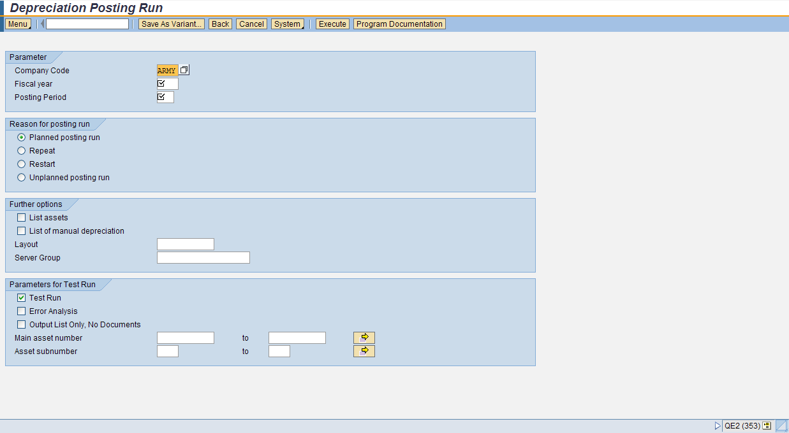
Input Fields
Required Fields
Optional Fields
Conditional Fields
Notes:
SHOW SLIDE 20: Input Fields
Facilitator’s Note:
There are 3 types of data entry fields:
Required Fields = R
Optional Fields = O
Conditional fields = C
The R/O/C column in the field description table represents the three types of data entry fields in SAP.
· R is for required fields that must be populated to complete a transaction.
· O is for optional fields that are not mandatory to complete a transaction.
· C is for conditional fields that are dependent on population of related fields and specific transactional events. On certain screens you may need to scroll to view additional data fields.
You will see these data entry fields when you utilize the user procedures and job aides within the PSW and Milwiki.
During the GFEBS training we will use only the Required Fields. Your unit policies or supervisor will designate what fields will be used for that location.

Slide 21
Radio Buttons and Checkboxes
Radio Buttons
Checkboxes
Notes:
SHOW SLIDE 21: Radio Buttons and Checkboxes
Facilitator’s Note:
Radio buttons offer a single select, while check boxes offer a multiple select

Slide 22
Status Bar System Messages
Status Bar
The Status Bar is located in the lower left corner of the screen. It displays information such as warning and error messages. There are three different types of status messages. Review the message types listed below.
Message Type Description
Error Message - Messages indicating incorrect entry in the system such as required or inaccurate data. You will not be able to continue with your transaction until these messages are addressed.
Information Message - Affirmative system message or messages displaying information on a transaction.
Warning Message - Messages that identify information that may possibly be an error. These messages may or may not allow you to continue with your transaction, depending on its function within the system.
Notes:
SHOW SLIDE 22: Status Bar System Messages
Facilitator’s Note:
Status Bar - The Status bar is located on the lower left corner of the screen. It displays information such as warning and error messages. There are three different types of status messages. Review the message types listed below.
Message Type Description:
Error Message - Messages indicating incorrect entry in the system such as required or inaccurate data. You will not be able to continue with your transaction until these messages are addressed.
Info Message - Affirmative system messages or messages displaying information on a transaction.
Warning Message - Messages that identify information that may possibly be an error. These messages may or may not allow you to continue with your transaction, depending on its function within the system.
Facilitator’s Note: Visual symbols of what to expect when there is an error, informational symbol, and a warning (caution) symbol. The caution does NOT indicate a hard-stop in the system.

Slide 23
Wildcard Characters
Using Wildcard Characters
- Performing wildcard search will increase system performance since fewer records will be pulled from the system.
Here are some examples of using a Wildcard search:
Placing the * at the end of a string causes the system to return all records that begin with the letters before the *.
Placing the * at the beginning of a string, the system will find all records that contains the characters at the end.
If you place the * at the beginning and end of the string, the system returns all records that contain the string at the beginning, middle, and/or end.
Notes:
SHOW SLIDE 23: Wildcard Characters
Using Wildcard Characters: Performing wildcard search will increase system performance since fewer records will be pulled from the system. Here are some examples of using a Wildcard search:
Placing the * at the end of a string causes the system to return all records that begin with the letters before the *.
Placing the * at the beginning of a string, the system will find all records that contains the characters at the end.
If you place the * at the beginning and end of the string, the system returns all records that contain the string at the beginning, middle, and/or end.

Slide 24
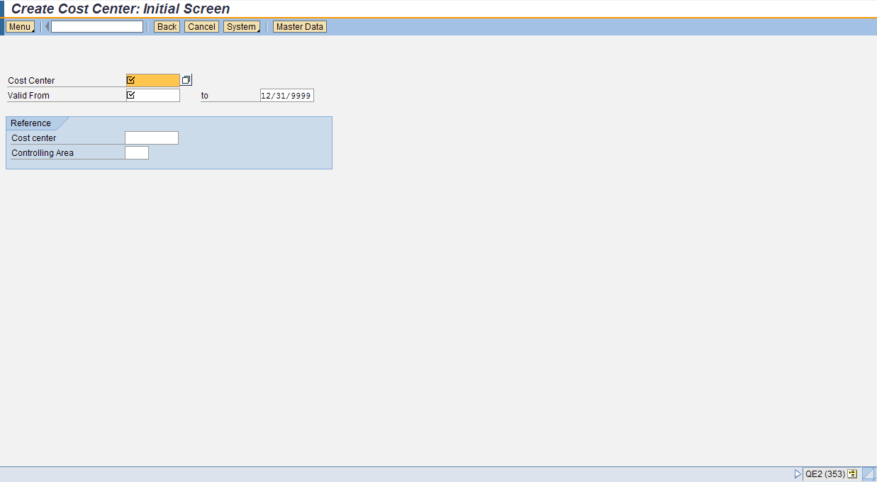
Match-codes
Match-codes allow users to select or search for a value from a list.
Matchcode Icon
Wildcard Characters
Notes:
SHOW SLIDE 24: Match-codes
Using Match-codes to search for data, Match-codes allow users to select or search for a value from a list.

Slide 25
25
Notes:
SHOW SLIDE 25: Check on Learning

Slide 26
Q. In order for the processor to begin a transaction, a ____ code needs to be entered in the ________ field (line), and then press enter.
Q. List the three types of Data Entry Fields.
Q. What allows users to select or search for a value from a list?
26
Notes:
SHOW SLIDE 26: Check on Learning

Slide 27
A C T I O N
Communicate GFEBS Overview
FC Leaders in a classroom environment working individually or as a member of a small group, using DFAS-IN Manual 37-100, FM 1-06, self-study exercises, personal experiences, practical exercises, handouts, and discussion.
C O N D I T I O N
- Communicate the goals of GFEBS in a clear and concise manner and without error
- Communicate the SAP platform for GFEBS without error
S T A N D A R D
27
Notes:
SHOW SLIDE 27: Terminal Learning Objective
NOTE: RESTATE TLO
During this lesson, we identified the overview and concepts of GFEBS, the modules of the different areas and touched on the roles involved. We also discussed the SAP platform, the 3 visual codes utilized to inform the processor if the transaction is good, cautioned, or red-flagged. Finally, we discussed multiple choices offered when the match-code box is selected.

